Slide 1
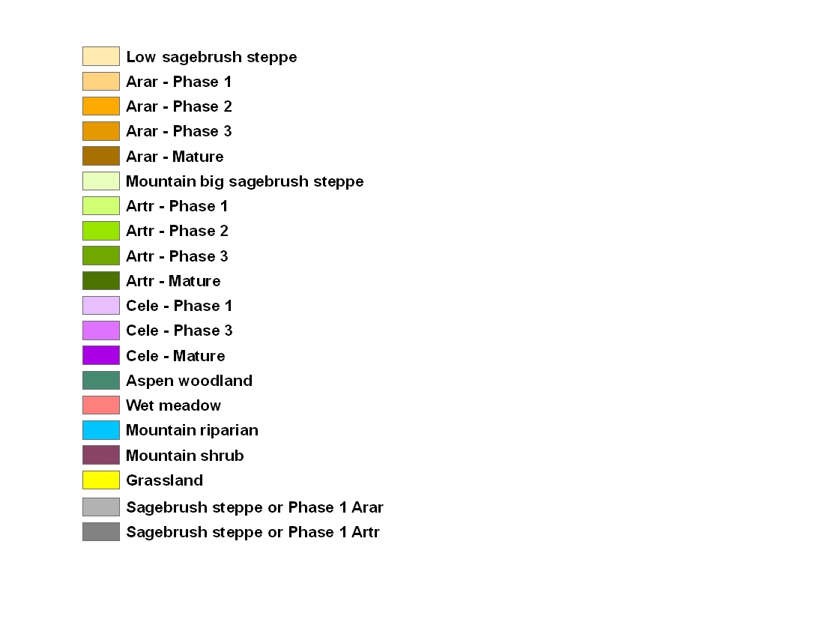

Slide 2

Year 2000, 30m

Slide 3


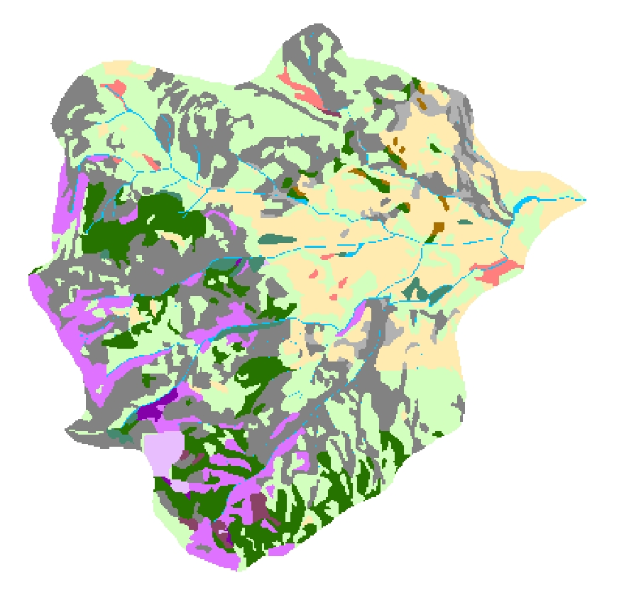
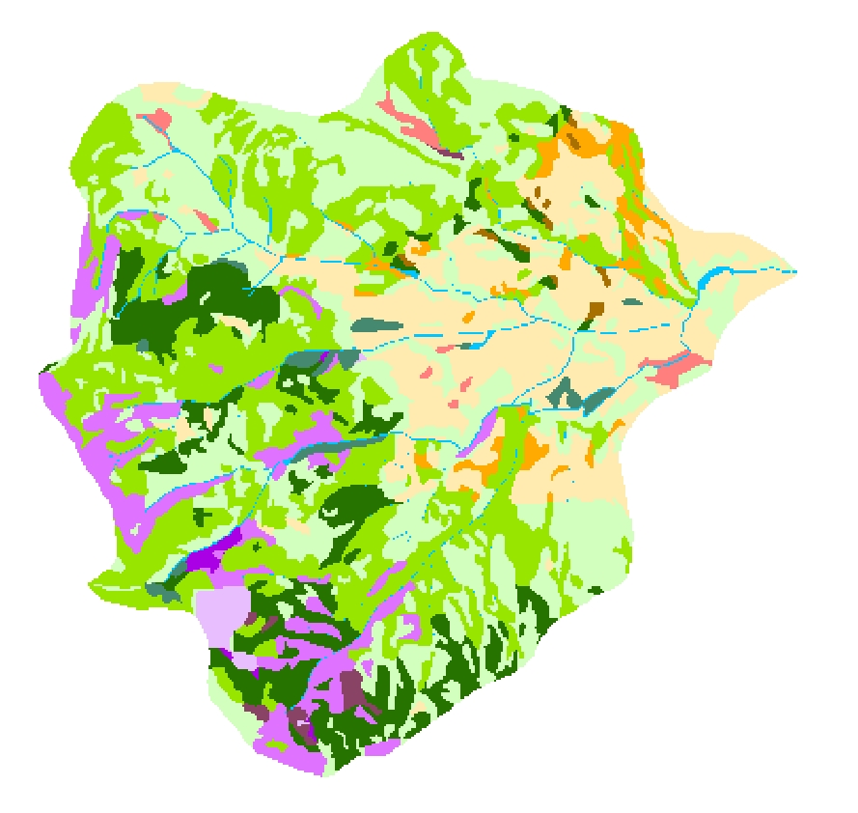
Year 2000, 30 m
Year 2000, 100 m
Year 2000, 500 m
Year 1800, 30 m
Year 1900, 30 m

Slide 4
Year 2000, 100m

Slide 5
Year 2000, 500m

Slide 6
Year 1800, 30m

Slide 7
Year 1900, 30m

